Slide 1
Property Website Development
A comprehensive guide to designing and building a property dealing website using modern web technologies.

Slide 2

Introduction
This presentation covers the design and development process of a property dealing website. It includes insights into web design principles, tools used, and the technologies that power the site functionality.

Slide 3
01
Web Design

Slide 4
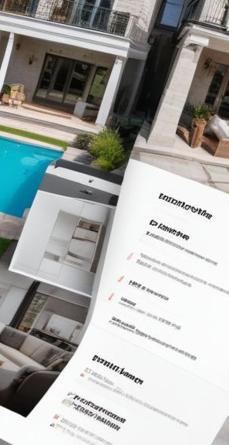
Design from Envato Market
Using Envato Market provides access to premium templates and designs for various websites. This allows for a professional appearance right from the start. Take advantage of available layouts and user interfaces that can be customized to fit specific needs for a property website.

Slide 5
Installation in Figma
Figma is a powerful tool for interface design and prototyping. It allows designers to collaborate in real-time. This slide covers how to import Envato design templates into Figma and adapt them for the development process, ensuring that the design is not only aesthetic but also functional and user-friendly.

Slide 6
Responsive Design Principles
Responsive design ensures that the website looks good on all devices, from desktops to smartphones. Key principles include fluid grids, flexible images, and media queries. This section discusses how these principles can be implemented in the design to provide an optimal user experience regardless of the device used to access the site.

Slide 7
02
Web Development

Slide 8
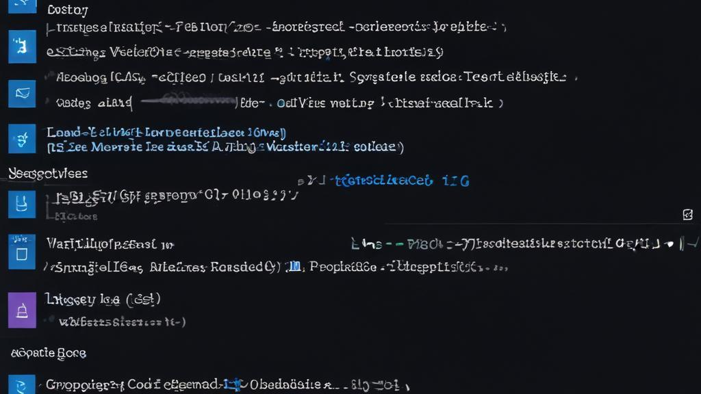
Using VS Code for Development
Visual Studio Code is a powerful code editor that supports multiple programming languages. It offers features like IntelliSense for code completion, debugging tools, and a wide range of extensions. For this project, VS Code is utilized to write, edit, and manage HTML, CSS, and JavaScript files, allowing for a streamlined development process.

Slide 9
Building Structure with HTML
HTML (HyperText Markup Language) forms the backbone of a website. This part of the presentation discusses how to structure the website by using appropriate HTML elements like headers, paragraphs, links, and forms designed for property listings. Proper HTML structuring enhances both SEO and accessibility for users.

Slide 10
Styling with CSS
CSS (Cascading Style Sheets) is used to style HTML elements and create visually appealing layouts. This slide explains how to apply styles to enhance the user experience, including typography, color schemes, and layout design using Flexbox and Grid. The aim is to ensure the website is not only functional but also attractive.

Slide 11
03
Functionality

Slide 12
JavaScript for Interactivity
JavaScript is essential for adding dynamic behavior to web pages. This part elaborates on how JavaScript is used to implement interactive features such as dropdown menus, form validations, and real-time property filtering. Understanding how to effectively use JavaScript enhances user engagement on the site.

Slide 13
MySQL for Database Connection
MySQL is a relational database management system used to store and retrieve property data efficiently. This section covers how to set up a MySQL database, connect it to the website, and perform CRUD operations (Create, Read, Update, Delete) to manage property listings and user inquiries seamlessly.

Slide 14
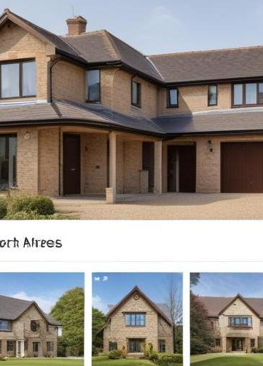
Search and Filter Properties
This segment focuses on the implementation of functionality to help users search for and filter properties based on specific criteria, such as location, price, and size. It discusses how to enhance user experience by developing intuitive search features and dynamic results, ultimately aiding in property selection.

Slide 15

Conclusions
The development of the property dealing website utilized various modern web technologies, including HTML, CSS, JavaScript, and MySQL. The overall process included design creation, learning tools like Figma and VS Code, and implementing functionalities that promote user engagement. This foundation can be built upon for future enhancements.

